Slide 2
Upgrades to the Horizon Simulation Framework
Brian Butler – L-3 Communications
Eric Mehiel – Cal Poly, San Luis Obispo

Slide 3
Presentation Overview
What is the Horizon Simulation Framework (HSF)?
Version History (1.0 – 2.1 )
Upgrades to Version 2.2
Dynamic Model Creation
Lua Scripting Support
Multi-threaded Processor Support
Performance Test Results
Conclusions and the Future of the HSF

Slide 4
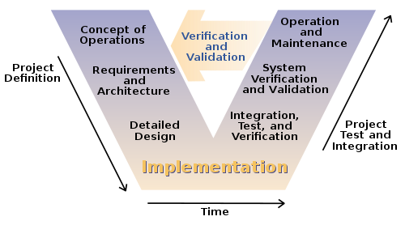
What problem is HSF trying to solve?
Verification and Validation of System Level Requirements can be difficult if the system is not operations
"Systems Engineering Process II" by Leon Osborne, Jeffrey Brummond, Robert Hart, Mohsen (Moe) Zarean Ph.D., P.E, Steven Conger https://commons.wikimedia.org/wiki/File:Systems_Engineering_Process_II.svg#/media/File:Systems_Engineering_Process_II.svg
Notes:
Main system level requirements can best be verified by simulation (Utility or Use Requirements)
Attack the problem by developing a model of the system that, when exercised, will simulate the behavior of the system over time

Slide 5
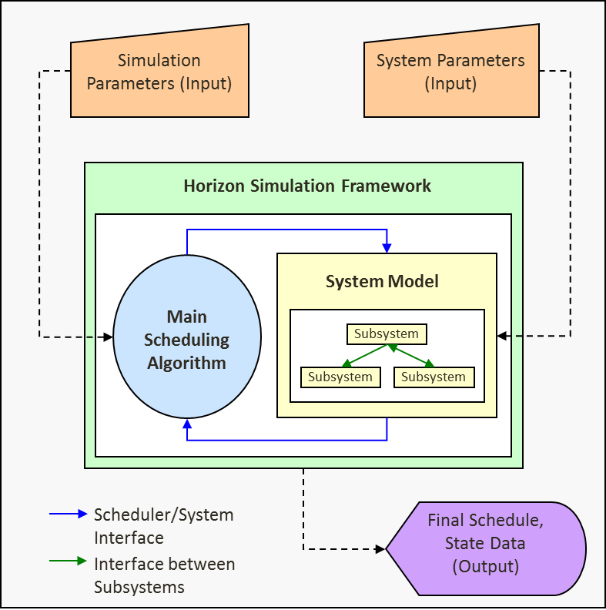
How is HSF structured?
Notes:
A state transition function coupled with a scheduling algorithm
Modeling Component
Input = state of system at t0 (state0)
Output = state of system at t1 (state1)
Architecture = a System comprised of subsystems
Scheduling Component
If the process of going from state0 to state1 does not violate any system constraints, the change in the state is scheduled as an event
To find the “best” schedule, the scheduler tries “all” possibilities

Slide 6
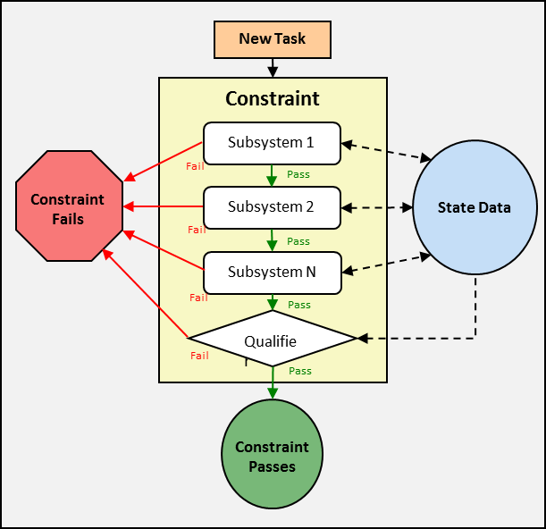
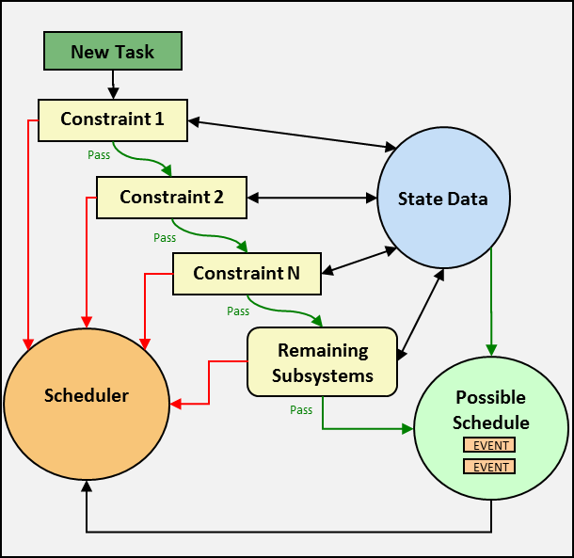
Modeling Relationships In HSF
SubsystemNode 1
SubsystemNode 2
SubsystemNode 4
SubsystemNode 5
SubsystemNode 6
SubsystemNode 3
SubsystemNode 7
SubsystemNode 9
Asset 2
Asset 1
SubsystemNode 8
SubsystemNode 10
SubsystemNode 11
Asset 3
SubsystemNode 12
Notes:
Constraints – a limit on values of a system state variable
Dependency – describes the relationship between one or more subsystems
Asset – a collection of subsystems with some significant meaning to the modeling engineer

Slide 7
HSF Output
System Schedule
Initial State
Asset Schedule 1
Event
Event
Event
Event
Asset Schedule n
Initial State
Event
Event
Simulation Time
A full description of the state of all subsystems and assets of the system
Notes:
A full state description of the system over a user specified time frame (a schedule)

Slide 8
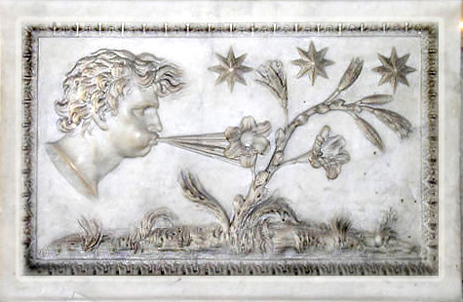
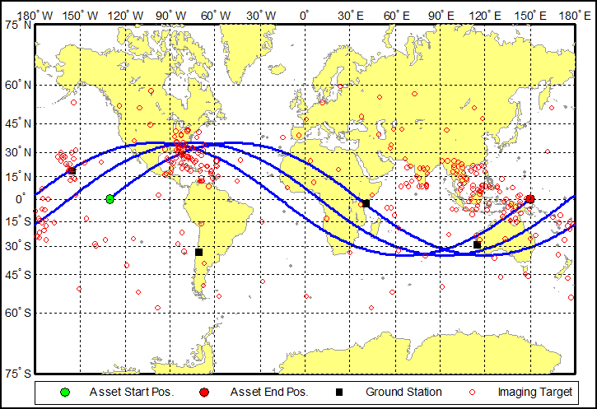
Example of using HSF
Aeolus: The Greek ruler of wind
Extreme-weather imaging satellite
Circular, 1000km, 35 degree inclined orbit
Simulation date: August 1st 2008 for 3 revolutions
Targets clustered into high-risk areas, including Southeast Asia and the Gulf of Mexico
Sensor has ability to generate data while in eclipse
A day-in-the-life of the Aeolus constellation
Notes:
Aeolus Test Case – Rev. In The Life used to verify a utility based system-level requirement

Slide 9
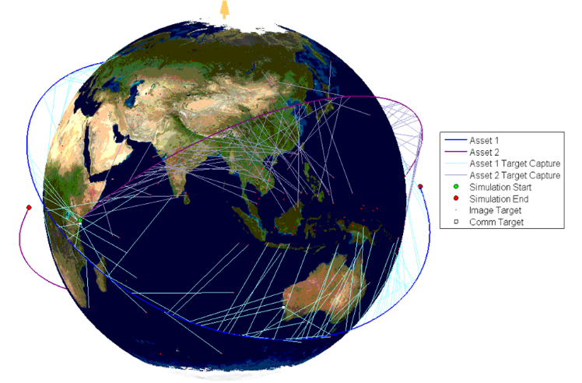
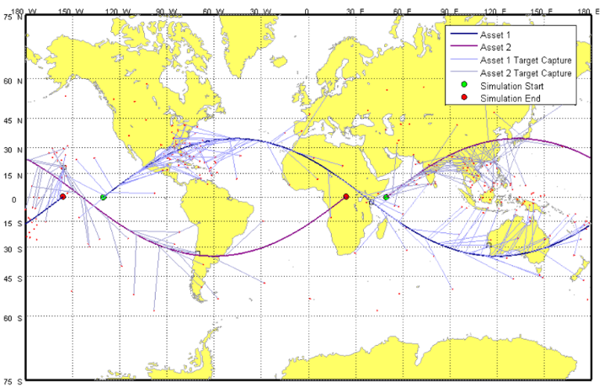
The Aeolus Results: Visualization
Matlab visualization of HSF simulation results

Slide 10
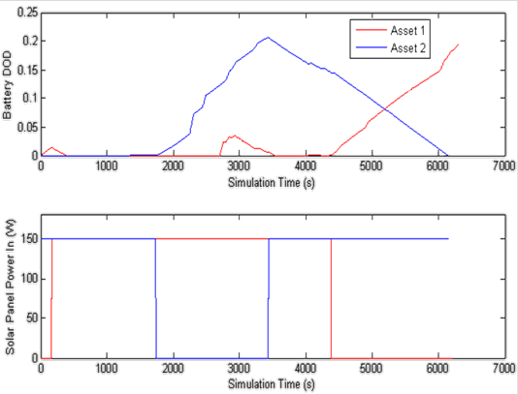
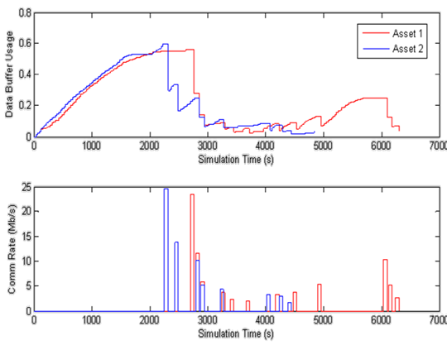
The Aeolus Results: Rev. In The Life Data

Slide 11
HSF version history
1.0 – Initial Release
1.1 – Math Libraries Added
1.2 – State Profile Added
2.0 – Multi-Asset Capability
2.1 – Auto Circular Dependency Check
All open source in C++

Slide 12
HSF Functional Overview @ v2.1
Task Inputs
(Custom Task File)
Simulation Parameters (Custom Simulation File)
System Parameters (Custom Model File)
Horizon Simulation Framework
System Model
Modeling Utilities
Main Scheduling Algorithm
Subsystem
Subsystem
Subsystem
Scheduler/System Interface
Code Interactions
Final Schedule, State Data (Output)
Interface between Subsystems
Input/Output Interfaces

Slide 13
Upgrade: Dynamic Model Creation
<MODEL>
<ASSET>
<SUBSYSTEM
Type=“scripted”
Name=“Sub 1”
SubId=”1”
</SUBSYSTEM>
<SUBSYSTEM
Type=“Sub 2”
SubId=”2”
<DEPENDENCY SubId="2"></DEPENDENCY>
</SUBSYSTEM>
</ASSET>
<ASSET>
<SUBSYSTEM
Type=“scripted”
Name=“Sub 3”
SubId=”3”
<DEPENDENCY SubId="2"></DEPENDENCY>
<DEPENDENCY SubId="4"></DEPENDENCY>
</SUBSYSTEM>
<SUBSYSTEM
Type=“Networked”
Name=”Sub 4”
host=”127.0.0.1”
port=”9999”
SubId=”4”
</SUBSYSTEM>
</ASSET>
</MODEL>
Subsystem “Sub1”
SubId: 1
Type: Scripted
Subsystem “Sub 2”
SubId: 2
Type: Compiled
Asset 1
Subsystem “Sub 4”
SubId: 4
Type: Networked
Host: 127.0.0.1
Port: 9999
Subsystem “Sub 3”
SubId: 3
Type: Scripted
Asset 2
Notes:
Problem: The form of the model was hard coded into the main() function
Solution: Use xml data files
Result: More flexibility in the types and functionality of system models

Slide 14
Dynamic Model Creation Detail
In version 2.1 only several (hard coded) subsystems were available to the user without modification to the codebase
Using an input file in xml format, the type of each subsystem and the structure of the system model is contained in the input file
Adding scripting also increased the flexibility of HSF by easily allowing customizable subsystem models (more next)

Slide 15
Upgrade: Lua Scripting Support
System Model
Main Scheduling Algorithm
Subsystem
EOMS
Subsystem
Subsystem
Schedule
Evaluator
Subsystem
Subsystem
Subsystem
Notes:
Problem: Many classes within HSF required manual modification and recompilation when functionality or variable types were changed or added
Solution: Add scripting support to different parts of the HSF to increase flexibility and eliminate user required code changes
Result: A more flexible and tightly integrate simulation tool

Slide 16
Lua Scripting Support Detail
Lua is a scripting language used in many C/C++ applications
A Lua Binding library allows the developer to bind Lua script calls to C/C++ function calls
The Lua scripts are then interpreted at run-time and the associated C/C++ functions are called

Slide 17
Lua Scripting Points
Lua Scripting was added to the follow components to increase the flexibility of the HSF
Subsystems
Initialization
canPerform
canExtend
Dependencies
Schedule Evaluator
Equations of Motion (EOMS)

Slide 18
Upgrade: Multi-Threading Support
Assign at most N schedules to threads
Have the last schedule been assigned to a thread?
Set pass/fail state for all remaining schedules
Wait for a thread to finish
Set schedule pass/fail state
Done!
Assign new schedule to a thread
Notes:
Problem: The baseline scheduling algorithm is formulated as “an embarrassingly parallel” problem
Solution: Add multi-threading at the highest level of the scheduling algorithm
Result: Improved performance with very little multi-threading overhead

Slide 19
Multi-Threading Support Detail
Since each proposed schedule is independent (lives in another universe) pass each new proposed schedule off to the next available thread for processing

Slide 20
HSF Functional Overview @ v2.2
Task Inputs
(Task XML File)
Lua Scripts (Input)
Simulation Parameters (Simulation XML File)
System Parameters (Model XML File)
Horizon Simulation Framework
Multi-Threading Support
Main Scheduling Algorithm
System Model
Scripting Utilities
Subsystem
Subsystem
Subsystem
Modeling Utilities
Scheduler/System Interface
Code Interactions
Final Schedule, State Data (Output)
Interface between Subsystems
Input/Output Interfaces

Slide 21
Lua Scripting Runtime Testing Results

Slide 22
Multi-Threaded Runtime Results

Slide 23
Conclusions and the Future of HSF
Three upgrades were made to HSF for v2.2
Dynamics Model Creation
Lua Scripting Support
Multi-Threading Support
Current/Future Work
Convert code base to C#/Python
Gather information about why the system cannot perform a task
Interplanetary model development

